Slide 1

Transition
with
ease
Plan name here
Presenter’s Name
TITLE
Notes:
RPCs: REVIEW NOTES AT BOTTOM OF THIS SCRIPT PAGE FROM THE BOTTOM UP FOR VARIABILITY INSTRUCTIONS.
**Script notes are written as if transition has already happened; adjust as needed if transition is still in progress.**
Welcome and thank you for joining me today. My name is [introduce yourself and give some background].
As you know, the [PLAN NAME] [use appropriate language depending on stage of transition.] Your employer chose us after an extensive review of plan providers across the country, and by the end of this presentation I hope you’ll feel confident that you have the best tools at your disposal to secure a comfortable retirement.
RPCs – Please review the following slides for variability FROM THE BOTTOM UP, then delete this slide when complete:
Slide 1 – Plan name, your name
PICK ONE – 5 or 6 (existing account balance)
PICK ONE – 7 or 8 (ongoing contributions)
PICK ONE – 9 or 10 (investment strategy)
PICK ONE – 11 or 12 (beneficiaries)
PICK ONE – 13 or 14 (loans)
Slide 16 – include if plan has company match
PICK ONE – 17 or 18 (match or no match)
Slide 19 – include if plan has employer contributions
Slide 21 – include if plan has Roth option
Slide 23 – delete investment options that are not included in plan; add in needed disclosures from slide 26
Slide 24 – delete if no PX
Slide 25 – delete if no SPL
Slide 26 – add needed disclosures to slide 23, then delete slide
Slide 27 – delete bullets/disclosures not included in plan
PICK ONE – 28 or 29 (P3 or CSC screenshots)
PICK ONE – 31 or 32 (statement screenshots)
Slide 34 – include only if transition is still in progress (blackout period)
PICK – 35 by itself or 36 and 37 (Limited Access Period or not)
Slide 40 – customize contact info
Slide 44 – insert client’s name in last line of disclosure

Slide 2

today’s
goals
Welcome to Transamerica
Your retirement savings
Tools and resources
Next steps
Notes:
Our goals today are pretty simple. I’m here to:
Tell you a bit about Transamerica
I’ll provide an overview of what the transition means for your retirement savings strategy
I’ll introduce you to some great tools and resources that can make it easier to set and reach your goals.
Finally, I’ll make sure you understand what you should do next.

Slide 3


why
Transamerica?
Exclusive focus
Extensive expertise
3.6 million participants
Award-winning service
Notes:
First, why did your employer decide to bring your retirement plan over to Transamerica? After an extensive review process, your employer chose us because of two things: our experience and our expertise. At Transamerica Retirement Solutions, retirement plans are our main focus, and we have more than 75 years of retirement plan experience. We’re known for making planning easy to understand and easy to do for the more than three million plan participants we serve across the country. And when you have a question, our award-winning customer service representatives will make sure you get the right answer for your situation.

Slide 4

what the move means
for your:
Existing Account Balance
Ongoing Contributions
Investment Strategy
Notes:
We’ll discuss what the move means for your
Existing account balance
Ongoing contributions and
Your investment strategy.

Slide 5
what the move means for your
existing account balance
Your retirement savings transferred to Transamerica.
Notes:
PICK ONE – SLIDE 5 or 6 – IF ACCOUNT BALANCES DID TRANSFER
Your previous account balance transferred over to your new Transamerica account. So your savings will continue to be invested.

Slide 6
what the move means for your
existing account balance
Your retirement savings are still with your former plan provider.
THREE CHOICES:
1
2
3
Transfer it to your new Transamerica account
Roll it over to an
IRA, either with Transamerica or another provider
Keep money with the old plan provider
Email us:
consolidate@transamerica.com
Call us:
800-275-8714
Review the fees and expenses you pay, including any charges associated with transferring your account, to see if consolidating your accounts could help reduce your costs. Be sure to consider whether such a transfer changes any features or benefits that may be important to you.
Employer-sponsored retirement plans may have features that you may find beneficial such as access to institutional funds,
fiduciary selected investments, and other ERISA protections not afforded other investors. In deciding whether to do a rollover from a retirement plan, be sure to consider whether the asset transfer changes any features or benefits that may be important to you.
Notes:
PICK ONE – SLIDE 5 or 6 – IF ACCOUNT BALANCES DID NOT TRANSFER
The money in your old account did not move to your Transamerica account. That leaves you with three choices:
Transfer it to your new Transamerica account.
Two, roll it over to an IRA, either with Transamerica or another provider.
Or, keep your money with the old financial provider.
Now I’m not here to give you a sales pitch, but I wanted to put all your options on the table. That’s because many people either don’t know that they can transfer to a new provider or even a new employer’s plan … or they think it’s just too much of a hassle to do. But the fact is, you can make this move if you want. So you might want to consider it. For one thing, putting all your retirement savings in one place can make it easier to track and manage your money, and if you’re worried about the paperwork, don’t be. We have a team of specialists who can make the process painless. They’ll help you compare your choices, and if you decide to make the move, they’ll walk you through every step. So if you’re interested, email us at consolidate@transamerica.com … or call 800-275-8714

Slide 7
what the move means for your
ongoing contributions
Your contribution rate (a.k.a. “savings rate”) has stayed the same and your automatic paycheck deductions will continue.
Consider saving as much as
you can — experts recommend 10%
You should evaluate your ability to continue saving in the event of a prolonged market decline, unexpected expenses, or an unforeseeable emergency.
Notes:
PICK ONE – SLIDE 7 or 8 – IF CONTRIBUTIONS ARE CONTINUING AT THE SAME SAVINGS RATE
If you were making contributions prior to the transfer to Transamerica, you’re automatically contributing the same amount to your account as you did before. You have the option to elect how your new contributions and existing balance are invested in the Plan, and may make changes at any time. If your employer has added to or changed the investment options in the plan, now would be a good time to revisit your investment strategy.
This can be an excellent time to log on and see what your existing savings rate is – it might be time to increase it. Many retirement planning specialists consider 10% of your paycheck a good rule of thumb for putting aside today’s money for tomorrow’s expenses. I’ll talk about savings goals in just a few more minutes.

Slide 8
what the move means for your
ongoing contributions
Your automated paycheck contributions have stopped – you have to create a new account with Transamerica and choose a new savings rate.
Consider saving as much as you can — 10% if possible!
You should evaluate your ability to continue saving in the event of a prolonged market decline, unexpected expenses, or an unforeseeable emergency.
Notes:
PICK ONE – SLIDE 7 or 8 – IF CONTRIBUTIONS HAVE STOPPED
At this point, your ongoing contributions have stopped [unless you have already taken action with Transamerica to make a new deferral election.] You’re automatic paycheck deductions will not continue until you log in to your new Transamerica account and re-set your contribution rate, which I will show you just how to do a little later.
Also, this can be an excellent time to reevaluate your savings rate – it might be time to increase it. Many retirement planning specialists consider 10% of your paycheck a good rule of thumb for putting aside today’s money for tomorrow’s expenses. I’ll talk about savings goals in just a few more minutes.

Slide 9
what the move means for your
investment strategy
Some investment options are the same as previous plan
Some investment options have been replaced with similar ones
Some new investment options have been added
Registered funds are available by prospectus only. You should consider the objectives, risks, charges, and expenses
of an investment carefully before investing. The summary prospectus and prospectus contain this and other information.
Read them carefully before you invest.
Notes:
PICK ONE – 9 or 10 – IF PLAN MAPPED INVESTMENTS & DELETE BULLETS IN SLIDE AS NEEDED
Know where your savings are being invested.
[Some investment choices from your previous plan are also included in your new plan.]
[Some investment choices in the old plan have been replaced by similar ones, and if you had money in those funds, your balances were “mapped” to their replacements.]
[Your employer added new options to your plan as well.]
[Now that the transition is done, you’re able to…] OR [Once the transition is done, you’ll be able to…], transfer balances and direct new contributions to any of them. Just be aware that certain funds might impose limits on how often you can transfer in and out of them.
You’ll find details about all your choices on your plan website. If you have any questions about specific funds, please ask me after the presentation.

Slide 10
what the move means for your
investment strategy
Your employer created a new selection of investment options for you to choose from
If you do not direct your contributions to any of these, you’ll be automatically invested
in the default fund
Notes:
PICK ONE – 9 or 10 – IF PLAN DID NOT TRANSFER INVESTMENTS
Now where are your savings being invested? Your employer decided to create a new investment option line-up for plan participants. You’ll have to log on to your new account – which I will show you how to do near the end of this presentation – and you’ll choose new investments. If you don’t, your ongoing contributions and existing balances will be invested in the plan’s qualified default fund.
[Now that the transition is done, you’re able to… ] OR [Once the transition is done, you’ll be able to…], transfer balances and direct new contributions to any of them. Just be aware that certain funds might impose limits on how often you can transfer in and out of them.
You’ll find details about all your choices on your plan website. If you have any questions about specific funds, please ask me after the presentation.

Slide 11
what the move means for your
beneficiaries
Former beneficiary information transferred to your new account
Take a moment to review and update
if needed
Remember: your will does not include your retirement assets
Notes:
PICK ONE – SLIDE 11 or 12 – IF BENEFICIARIES TRANSFERRED
On top of your money – your existing account balance, your contributions and your investments – you also have to think about your designated beneficiaries.
Your former beneficiaries were transferred to your new account, but you may want to take a moment to review and update them as needed.
Remember, even if you’ve outlined in your will what will happen to your assets after your death, your retirement plan beneficiary designation, made in accordance with the plan’s terms, will dictate what happens to your retirement plan assets, not your will. And if you don’t have a designation on file, your retirement plan account will be distributed according to the provisions of the plan — so make sure your designation is up to date, and review it on a regular basis.
[Use for cases with Level One outsourcing.] You can update your beneficiary designation with us once the transition is complete. Just fill out a form, which you can get from [your employer] or by calling 800-755-5801. Keep in mind that if you’re married and want to designate someone other than your spouse as a primary beneficiary, your spouse may need to provide consent.
[Use for cases with Level Two or Three outsourcing.] You can update your beneficiary designation with us once the transition is complete by visiting my.trsretire.com. Keep in mind that if you’re married and want to designate someone other than your spouse as a primary beneficiary, your spouse may need to provide consent.

Slide 12
what the move means for your
beneficiaries
Former beneficiary information was not transferred to your new account
Add in beneficiary information
Remember: your will does not include your retirement assets
Notes:
PICK ONE – SLIDE 11 or 12 – IF BENEFICIARIES WERE NOT TRANSFERED
In addition to your money – your existing account balance, your contributions and your investments – you also need to consider your designated beneficiaries.
Your former beneficiaries were not transferred to your new account, so you will have to provide their information.
Remember, even if you’ve outlined in your will what will happen to your assets after your death, your retirement plan beneficiary designation, made in accordance with the plan’s terms, will dictate what happens to your retirement plan assets, not your will. And if you don’t have a designation on file, your retirement plan account will be distributed according to the provisions of the plan — so make sure your designation is up to date, and review it on a regular basis.
[Use for cases with Level One outsourcing.] You can update your beneficiary designation with us once the transition is complete. Just fill out a form, which you can get from [your employer] or by calling 800-755-5801. Keep in mind that if you’re married and want to designate someone other than your spouse as a primary beneficiary, your spouse may need to provide consent.
[Use for cases with Level Two or Three outsourcing.] You can update your beneficiary designation with us once the transition is complete by visiting my.trsretire.com. Keep in mind that if you’re married and want to designate someone other than your spouse as a primary beneficiary, your spouse may need to provide consent.

Slide 13
what the move means for your
outstanding loans
Balance moved to Transamerica
Repayments continue through automatic payroll deductions
Retirement plan loans are subject to plan restrictions. The Plan document will govern.
Notes:
PICK ONE – SLIDE 13 or 14 – IF LOAN BALANCE MOVED TO TRANSAMERICA
Any loans you have against your account also transferred to us when the plan did, and nothing else about them changed—your repayment schedule, payment amounts, and the way you make your payments are still the same.

Slide 14
what the move means for your
outstanding loans
Outstanding loan(s) stayed with prior provider
Can’t transfer account balance until loan(s) repaid
Notes:
PICK ONE – SLIDE 13 or 14 – IF LOAN BALANCE DID NOT MOVE TO TRANSAMERICA
If you had a loan against your account that you haven’t paid off yet, you should have received information about it before the plan moved to Transamerica. But in case you didn’t, two things you should know:
First, your former plan provider requires that any outstanding loan stays with them. This means you’ll have to keep sending your payments to them … and if you used to do that through payroll deduction, you’ll have to arrange a new payment plan. So, contact your old provider for details.
Second, your old account balance did not transfer to Transamerica—and it can’t until your loan is paid off in full. Now, this doesn’t mean you can’t start saving with us and taking advantage of everything we offer—you absolutely can, and you definitely should. But don’t be surprised when you set up your Transamerica account and it looks like you’re starting from scratch. Once you pay off your loan, PICK ONE: [all your old money will move into your new account automatically.][you can move all your old money into your new account. Simply call us at 800-755-5801, and our representatives will be happy to help.]

Slide 15

plan
highlights
Notes:
Now let’s talk about some of your plan’s key provisions … that is, the basic features and rules that govern what you and your plan sponsor can or must do, and when.

Slide 16
extra
benefits
Receive additional money from your employer
(RPCs – insert formula if you know it; delete bullet if you don’t) Your employer will match the first [X%] that you contribute from your paycheck, up to [X% or $X]
Max your match*: Contribute at least enough to earn your full employer match
Company match
*Matching contributions are subject to plan eligibility and vesting requirements. Descriptions of plan features and benefits are subject to the plan document, which will govern in case of inconsistencies.
Notes:
USE IF EMPLOYER OFFERS A MATCH; edit second bullet if known, delete if unknown
Your plan includes a company match, which is a benefit that many employers do not offer – you could think of this as part of your overall compensation package.
How it works: Your employer will match some of the contributions you make to your account with deposits of their own. [IF RPC KNOWS THE FORMULA] Your employer will match the first [X%] that you contribute from your paycheck. So if you contribute at least [X%], your company is going to GIVE YOU the same amount! If you contribute less than what they’re willing to match, they’ll only match you at that lower percentage.
I cannot stress enough the importance of electing a savings rate that allows you to get the full match of what your company is offering. This is a benefit you can’t afford to overlook. Speaking of your savings rate…

Slide 17




set your
savings goals
Match
10%
Max
Get your full
employer match
Contribute 10%
of your current pay
Your maximum contribution:
$18,000
($24,000 if age 50+)
Matching contributions are subject to plan vesting requirements. Descriptions of plan features and benefits are subject to the
plan document, which will govern in case of inconsistencies.
Notes:
USE IF EMPLOYER OFFERS A MATCH
Keeping the match in mind, the first thing you’ll need to decide is how much of your paycheck you can set aside for retirement. But how do you decide what savings rate is right for you? Like I said earlier, this is an ideal time to reevaluate your retirement saving strategy.
While everyone’s situation is a little different, there are three goals that are easy to remember and worth aiming for:
First, consider contributing at least enough to get the maximum match from your employer. [And who can tell me what the company match is? It was just in the last slide!]
Once you're saving at least that much, think about saving more – you may want to aim to contribute at least 10% of your pay. Many retirement planning specialists consider this a rule of thumb for putting aside today’s money for tomorrow’s expenses.
The last step would be to shoot for saving up to your plan’s maximum contribution amount–$18, 000 this year, $24,000 if you’re 50 or older. That will put you on the path toward a brighter retirement.
No matter where you start or how far you need to go, keep these goals in mind and push yourself to the next highest goal over time–the sooner the better.

Slide 18
set your
savings goals
5%
10%
Max
Contribute 5%
of your current pay
Contribute 10%
of your current pay
Your maximum contribution: $18,000
($24,000 if age 50+)
Notes:
USE IF EMPLOYER DOES NOT OFFER A MATCH
Now is an ideal time to reevaluate your retirement saving strategy. But how do you decide what savings rate is right for you? While everyone’s situation is a little different, there are three goals that should be easy to remember and worth aiming for.
First, consider contributing at least 5% of your current pay to get started.
Once you reach that goal, or if you’re already thinking of saving more, you may want to aim to contribute at least 10% of your pay. Many retirement planning specialists consider this a rule of thumb for putting aside today’s money for tomorrow’s expenses.
The last step would be to shoot for saving up to your plan’s maximum contribution amount–$18,000 this year, $24,000 if you’re 50 or older. That will put you on the path toward a brighter retirement.
No matter where you start or how far you go, keep these goals in mind and push yourself to the next highest goal over time–the sooner the better.

Slide 19

extra
benefits
Your employer will contribute money to your retirement account, as a nondiscretionary contribution, if you have met the necessary eligibility requirements!
(RPCs – insert the amount if you know it; delete bullet if unknown) Employer contribution: [$X or X%], [varies by year]
Employer contributions
Employer contributions are subject to plan eligibility and vesting requirements. Descriptions of plan features and benefits are subject to the plan document, which will govern in the event of any inconsistencies.
Notes:
USE IF PLAN INCLUDES EMPLOYER NONDISCRETIONARY CONTRIBUTIONS
Your company decided to include an employer contribution as one of its extra benefits in the plan. This is a very rare – and very amazing – perk. Your employer will contribute to your account on your behalf, without any required action on your part! However, to make the most of these contributions and take advantage of all of the investment options and tools, we strongly suggest you - say it with me now – Join the Plan.
Your employer will contribute [$X or X%], [varies by year].

Slide 20
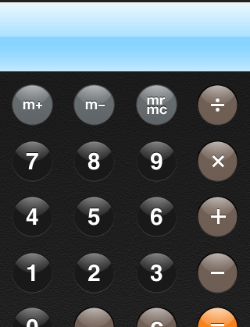

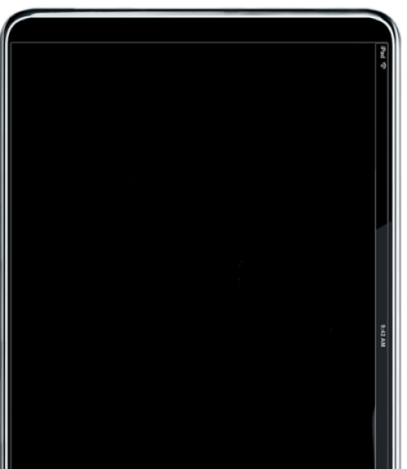

tax
advantages
Pretax contributions may cut current federal taxes
Earnings compound tax-deferred year after year
35,000
- 1,750
33,250
Annual income
– Retirement plan savings
= Lower current taxable income
Generally, your pre tax contributions, plus investment earnings
and dividends, are subject to income taxes upon withdrawal.
Notes:
20
[In addition to these benefits,] There are [also] tax benefits to joining the plan. The federal government offers tax advantages to encourage people to save for retirement through their employer’s plan.
Remember I said that your savings would be deducted from your pay automatically? Those savings usually go from payroll to your plan account before taxes are calculated. That means you’ll be taxed on a lower amount of income. For example, say you earn $35,000 a year, and put aside 5 percent of that in your plan. Take away that 5 percent—$1,750 in this case---and you’ll be taxed as if you earn just $33,250. So depending on your financial situation, that could save you in taxes right up front.
I also want to note that this advantage continues as long as your savings stay in the plan.
As they say in commercials: But wait—there’s more! How many of you have ever received a 1099 form for interest on savings accounts? That interest has to be reported to the IRS and is taxed as regular income each year. But within your retirement plan, your earnings avoid taxes until you withdraw them at retirement-- so more money keeps working for you year after year. This is known as tax-deferred compounding—your earnings get earnings of their own, all untouched by Uncle Sam.

Slide 21
tax
options
now
later
PAY
PAY
OR
Roth:
Contributions made after taxes are calculated
Traditional:
Pay taxes on withdrawals as you take them
You should consult with a tax advisor to determine what deferral election is best for your individual circumstances.
Notes:
USE IF PLAN HAS ROTH OPTION
Your plan also gives you some flexibility as to when to take advantage of these tax benefits.
Your plan includes something called a Roth option. With a Roth Plan, you can choose to make some or all of your contributions into the Roth account. Taxes on Roth Contributions are paid in the current year. People tend to make Roth contributions if they think they’ll be in a higher tax bracket when they’re older (and would have to pay more taxes). If you choose Roth and pay the taxes on your contributions now, you’re done; when you’re ready to retire and start withdrawing your retirement savings – you’ll get it tax free! I’m happy to explain the Roth option in more detail to anyone interested.
In the traditional plan, your contributions go into the plan tax-deferred, but then when you’re ready to withdraw the money at retirement, you’ll have to pay taxes.

Slide 22

investments
Notes:
Now let’s talk investments – prior to moving to Transamerica, your money was either invested in a default investment strategy, or you were able to pick and choose your investments. What investment choices will you have now with Transamerica? [RPC: reiterate if funds were mapped, or if they’ll have to select entirely new funds]

Slide 23
investments
1
One-step solution
PortfolioXpress®
SecurePath for Life ®
Custom Model Portfolios
Transamerica Managed Account
Target Date Funds
Asset Allocation Funds
See important information about these one-step solutions that follow.
Notes:
RPC: remove bullets and script notes that do not apply to this plan. Add in disclosures found on slide 26.
No matter what kind of investor you are – or want to be! – we have an answer for you. It starts with the type of approach you want to take–you can choose a professionally managed, one-step solution…or do it yourself.
Let's start with the professionally managed, one-step choices you have.
PortfolioXpress®:Uses the funds available in your plan to provide a diversified investment mix based on the year you expect to retire [and the level of risk you’re most comfortable with]. It shows you an investment allocation for today and a schedule of changes, or glide path, for tomorrow . If you agree, the service automatically rebalances your current holdings and new contributions to reflect your target mix, rebalances your portfolio each quarter to maintain your mix, and gradually adjusts your mix to become more conservative as you approach retirement. Please read the next slide for some important information about PortfolioXpress®.
SecurePath for Life®: And if you’re at least age 50 or will be this year, there’s also an option called SecurePath® for Life. This diversified investment has optional features that can provide protection of income, take advantage of market gains and, most important, provide guaranteed income for life. You can find out the details on your plan website, but please read the information on the next slide as well.
Custom model portfolios: Your plan sponsor [and the plan’s advisor] has/have created a series of custom portfolios that make it easy to diversify among the mutual funds in your plan. Here’s how it works: You choose your risk tolerance or a certain risk-versus-reward target. The service establishes a portfolio, or investment mix, based on that choice. Then it rebalances your account to match the portfolio you chose, and automatically rebalances it over time to maintain your target mix. Now, you should consider your whole financial picture when you use this service for your retirement account. So first review the details on your plan website to make sure it’s the right choice for you.
Transamerica Managed Account: This service may be right for you if you have more retirement savings outside the plan. Using the funds in your plan, the Managed Account allocates your plan assets based on your goals, what you’ve saved inside and outside your account, and your time horizon … all while using money management services from Ibbotson Associates, one of the nation’s leading independent allocation specialists.
Target Date Funds: Your plan includes a family of target date funds, each one designed with a target retirement year as its “end goal”. The mix of stocks and bonds in each fund grow more conservative as the target year approaches, so you simply choose the fund whose target is closest to the year you expect to retire.
Asset Allocation Funds: Your individual options also include asset-allocation, or balanced, funds. These hold a mix of stocks and bonds based on risk, and they maintain that same mix over time. So if you choose one, you may want to revisit it down the road as your situation changes.

Slide 24
PortfolioXpress
®
PortfolioXpress® is a registered service mark of Transamerica Retirement Solutions Corporation (Transamerica). PortfolioXpress® presents a series of asset allocation models up to and through a designated retirement year. You are solely responsible for selecting the retirement year and risk preference (if applicable). In implementing the service, you agree to each asset allocation mix and automated rebalancing transaction that will take place over time within the account as you approach the selected retirement year. If you sign up, you should carefully review the service agreement for details on any applicable fees and other terms and conditions that may apply.
PortfolioXpress® is designed as investment education. Transamerica does not provide investment advice. Retirement date portfolios are subject to the same risks as the underlying assets in which they invest. In general, the higher the portfolio’s allocation to stocks, the greater the risk. The principal value of the portfolio is never guaranteed, including at and after the target date. Diversification does not guarantee against loss in a falling market.
Notes:
[Use if PX is offered]

Slide 25
SecurePath for Life
®
SecurePath for Life® consists of a group variable annuity contract which offers certain guaranteed lifetime withdrawal benefits to participants. Although SecurePath for Life® provides a guaranteed income base as well as a guaranteed income amount consisting of a guaranteed lifetime withdrawal benefit, the investment options available under the product are variable investments and may lose value. Certain withdrawals will reduce a participant’s income base, and therefore the guaranteed income amount.
Your plan sponsor may exercise certain rights under the group variable annuity contract that may terminate the guaranteed lifetime withdrawal benefits available to you, including termination of the contract, termination of the plan, or the transfer of the assets left under the contract to another investment fund. Guarantees are subject to the terms and conditions set forth in the contract and the prospectus. Group annuity contracts are issued by Transamerica Life Insurance Company (TLIC), 4333 Edgewood Road NE, Cedar Rapids, IA 52499, which is licensed and offers products in all states except New York. Withdrawal guarantees provided under SecurePath for Life® are supported by TLIC’s general account and are contingent on the claims paying ability of TLIC.
Group annuity contracts are issued by Transamerica Life Insurance Company (TLIC), 4333 Edgewood Road, NE, Cedar Rapids, Iowa 52499, which is licensed and offers products in all states, except New York. Guarantees of withdrawals provided under SecurePath for LifeTM are supported by TLIC’s general account and are contingent on the claims paying ability of TLIC. Group annuity contracts issued in New York are issued by Transamerica Financial Life Insurance Company (TFLIC), 440 Mamaroneck Avenue, Harrison, NY 10528, which is licensed in New York. Guarantees of withdrawals provided under SecurePath for Life® are supported by TFLIC’s general account and are contingent on the claims paying ability of TFLIC. Product features and availability may differ by state.
Notes:
[Use if SPL is offered]

Slide 26
Disclosures for slide 23
Custom Model Portfolios: When considering a custom portfolio, first think about your personal circumstances, market outlook, risk tolerance, and the potential universe of appropriate investments. If you subscribe to the service, your account will be rebalanced to the portfolio option you select. From time to time, funds may be added to or removed from the custom portfolio mixes, or changes may occur to the portfolios’ target investment allocations. The custom model portfolios are subject to the same risks as the underlying assets in which they invest. The higher the portfolio's allocation to stocks, the greater the risk. The portfolio's principal value is never guaranteed. Maintenance of these portfolios is the responsibility of <name of employer><name of advisor>.Transamerica Retirement Solutions does not provide advice to your account.
Transamerica Managed Account: Ibbotson Associates®, Inc. is an independent, third-party, SEC-registered investment adviser that provides the investment advice and portfolio management methodologies for the Managed AccountSM service. Neither Transamerica Retirement Solutions nor Ibbotson is responsible for selecting the core investment options available within the plan.
Target date funds generally invest in a mix of stocks, bonds, cash equivalents, and potentially other assets, either directly or via underlying investments, and may be subject to all the risks of these assets. The allocations become more conservative over time: The percentage of assets allocated to stocks will decrease while the percentage allocated to bonds will increase as the target date approaches. The higher the allocation is to stocks, the greater the risk. The investment option’s principal value is never guaranteed, including at and after the target date.
Asset allocation funds invest in a mix of stocks, bonds, cash equivalents, and potentially other types of assets, either directly or via underlying investments, and are generally considered diversified investment choices. Allocation funds may be subject to all of the risks of the assets in which they invest. The higher the fund’s allocation to stocks, the greater the risk. Asset allocation and diversification do not assure better performance, cannot eliminate the risk of investment losses, and do not protect against an overall declining market.
Notes:
[Insert these disclosures into slide 23 as needed.]

Slide 27
investments
2
Do it yourself
Variety of investment choices
Schwab PCRA (brokerage)
Schwab Personal Choice Retirement Account® (PCRA) is not a fund but rather a participant self-directed brokerage account maintained at Charles Schwab & Co., Inc. Participants must individually apply for PCRA and are solely responsible for their fund selections made under the PCRA. Commissions and transaction fees may apply to fund trades placed outside of the Schwab Mutual Fund OneSource® program or trades on other investment vehicles available through Schwab. An annual fee of $50 will be applied by Transamerica Retirement Solutions if you invest in the Schwab PCRA. Securities purchased through the PCRA are available through Charles Schwab & Co. Inc., (Member SIPC). Charles Schwab & Co., Inc. is not affiliated with Transamerica.
Notes:
RPC: remove bullets and script notes that do not apply to this plan.
On the other hand, if you’re experienced, know how you want to build your portfolio, or just prefer a hands-on approach, you can choose among a range of investment choices options screened by your employer. You’ll probably want to diversify your investments based on your time horizon and risk tolerance. If you do, you should rebalance your portfolio periodically to make sure your investment mix continues to match your situation. Our free auto-rebalance service makes that easy to do too.
What’s more, you’re not even limited to the funds in your plan. You can also invest through a Schwab Personal Choice Retirement Account—PCRA for short. This self-directed brokerage account gives you access to thousands of other investment options. There’s a separate sign-up and an annual fee, along with trading costs you could incur, but you’ll be able to track your PCRA balance on your [INSERT PLAN NAME] website along with the rest of your Transamerica account.

Slide 28

tools and
resources
Notes:
FOR P3 PLANS
I think you’ll find that Transamerica makes it easy for you to track and manage your account online.

Slide 29

tools and
resources
Notes:
FOR EM PLANS NOT ON P3
I think you’ll find that Transamerica makes it easy for you to track and manage your account online.

Slide 30





SM
Less than 65%
65 – 79%
80 – 94%
95 – 100%
Rainy
Cloudy
Partly
Sunny
Sunny
IMPORTANT: The projections or other information generated by the OnTrack® tool, which generates Your Retirement OutlookSM, regarding the likelihood of various investment outcomes are hypothetical, do not reflect actual investment results, and do not guarantee future results. Results derived from the OnTrack® tool may vary with each use and over time. Please visit your plan website for more information regarding the criteria and methodology used, the tool’s limitations and key assumptions, and other important information.
See the end of the presentation for more about OnTrack®.
Notes:
Arguably the most valuable tool at your disposal is Your Retirement OutlookSM… a quick, personalized way to gauge your savings progress in real time. It can even alert you to take action when or if you’re falling behind.
Specifically, Your Retirement OutlookSM is our name for the gap between your retirement income goal and how much income your current strategy is likely to produce when you retire. You can learn it when you set up your account online by answering a few simple questions about your retirement savings. Once you do, you’ll see one of these four weather icons – rainy, cloudy, partly sunny, or sunny. Each one represents how much of your goal your current strategy is likely to reach.
Obviously, you want your forecast to be sunny. But don’t worry if it’s not. Your Retirement OutlookSM is a real-time gap analysis…a snapshot of where you stand versus your goal–right now. You create it by using our powerful OnTrack® planning tool. But OnTrack® doesn’t just show you your current forecast; it also shows you how you may potentially improve it. That could mean you need to save more … or maybe you just need to say more. That’s because the more information you provide about your retirement savings – including any outside accounts, income or expenses you expect for both yourself and your spouse or partner – the more comprehensive Your Retirement OutlookSM will be. What’s more, your forecast updates automatically every time you sign in to your account.

Slide 31
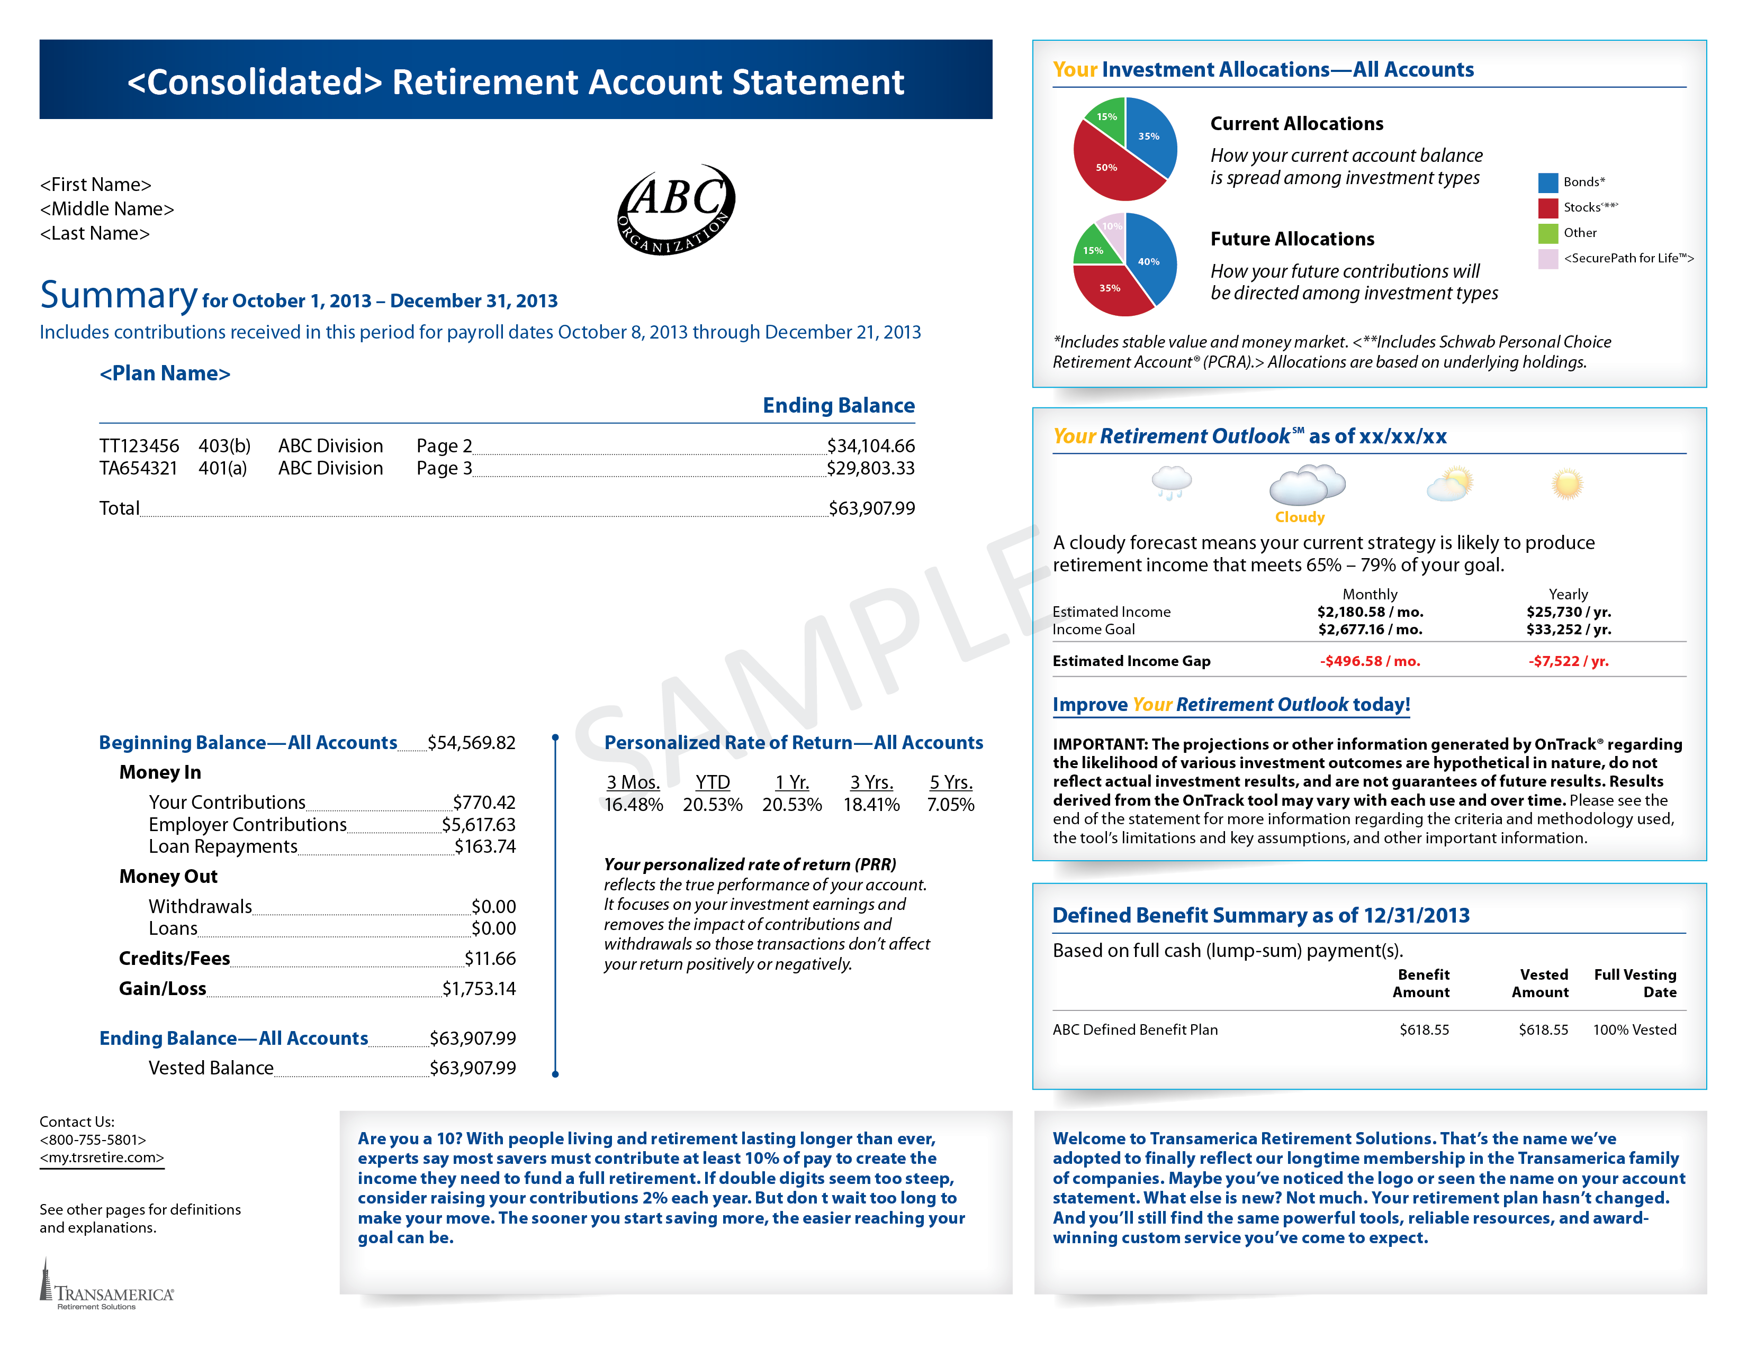
account
statements
Notes:
FOR P3 PLANS
If you haven’t already, you’ll receive a final account statement from [current provider]. Soon you’ll receive a quarterly statement from Transamerica … either by snail mail or, if you sign up for e-documents, through email alerts when your statements are ready online.
Now, your statement is designed to make it easy to find the information you want. For example, Money In means just what it sounds like—money that entered your account during the period the statement covers. This includes your contributions as well as any that might have come from your employer. And if you’ve paid back anything you borrowed from your account, or transferred any in from outside, that will show up too.
Money Out shows the opposite—withdrawals, distributions and loans.
Credits/Fees will appear for certain funds if your plan adjusts them to ensure that all participants cover the same costs to administer the plan.
Gain/Loss reflects dividends, capital gains, interest, and change in value during the statement period. But maybe more important is your personalized rate of return. This shows how your investments have actually performed over various periods, not including money that was added to your account.
Your Investment Allocations shows how your current balances—and new contributions—are divided among the funds in your plan.
Your Retirement OutlookSM —that’s the forecast we talked about a few minutes ago, though it’s a snapshot from the day your statement was generated, not real-time like you’ll find online.
You also might see special messages from your plan or Transamerica. And if you have a defined-benefit plan with us, you’ll see your projected payouts and vesting information as well.

Slide 32
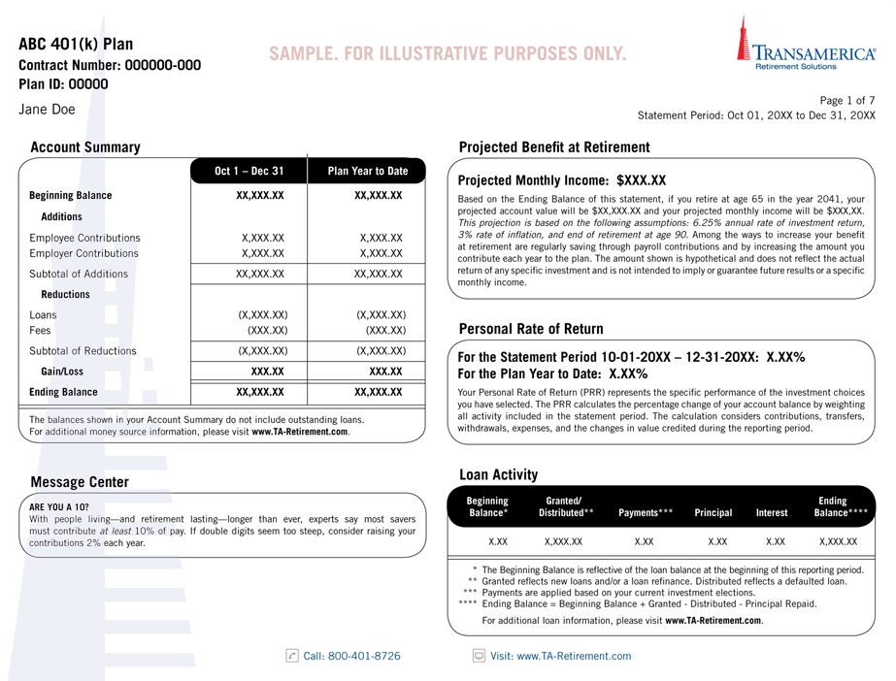
account
statements
Notes:
FOR EM PLANS NOT ON P3
If you haven’t already, you’ll receive a final account statement from [current provider]. Soon, you’ll receive a quarterly statement from Transamerica … either by snail mail or, if you sign up for e-documents, through email alerts when your statements are ready online.
Now, your statement is designed to make it easy to find the information you want. For example, Money In means just what it sounds like—money that entered your account during the period the statement covers. This includes your contributions as well as any that might have come from your employer. And if you’ve paid back anything you borrowed from your account, or transferred any in from outside, that will show up too.
Money Out shows the opposite—withdrawals, distributions and loans.
Credits/Fees will appear for certain funds if your plan adjusts them to ensure that all participants cover the same costs to administer the plan.
Gain/Loss reflects dividends, capital gains, interest, and change in value during the statement period. But maybe more important is your personalized rate of return. This shows how your investments have actually performed over various periods, not including money that was added to your account.
Your Investment Allocations shows how your current balances—and new contributions—are divided among the funds in your plan.
Your Retirement OutlookSM —that’s the forecast we talked about a few minutes ago, though it’s a snapshot from the day your statement was generated, not real-time like you’ll find online.
You also might see special messages from your plan or Transamerica. And if you have a defined-benefit plan with us, you’ll see your projected payouts and vesting information as well.

Slide 33
one place to manage
your savings
Consolidate other retirement
plan assets you may have to:
Easily manage your savings
Get a more complete view
Stay diversified
In some cases your prior provider may charge a surrender or withdrawal fee for transferring your account. Contact the provider to confirm if any fees apply to you. Review the fees and expenses you pay, including any charges associated
with transferring your account, to see if consolidating accounts could help reduce your costs. Be sure to consider whether
a transfer changes features or benefits that may be important to you.
Notes:
If you’re new to the plan because of a job-change and/or have started saving in a previous employer plan, you may want to consider consolidating your assets.
And don’t think I’m saying “put all your eggs in one basket” – I still want you to have diversified investments. But here I’m talking about keeping all your various retirement accounts in one place, so it will be easier for you to see the big picture. The money itself should still be invested in a diverse mix of funds.
There are 2 ways you can consolidate your assets with Transamerica. Both give you the advantage of being able to see all of your money in one place -- so that when you use the OnTrack ® tool to see your Outlook, you will be able to see all of your retirement assets. The two options are:
1). You can roll that money into the plan, giving you access to the same investment options, services and features that you have through your employer's plan. One of the biggest advantages is that the fees you pay in the plan are typically lower than what you would have to pay for those same funds on your own. But your account will be assessed any other administrative fees.
2). Alternatively, you can roll that money to a Transamerica IRA, which gives you more investment flexibility and access to investment advice, if you'd like. You might consider this option if you don't want all of you retirement assets with your current employer for whatever reason.

Slide 34

what happens during the
blackout period
While the transition is in progress, you will not be able to access your account
This is known as the
“blackout period”
Notes:
USE IF TRANSITION IS IN PROGRESS – DISCUSS BLACKOUT DATES
The process of transferring your employer’s retirement plan from [OLD PROVIDER] to Transamerica is still in progress.
You will not have access to your account beginning [DATE]. You will be able to access your new Transamerica account the week ending DATE. This window is called a blackout period – and the reason for it is we need to make sure all the parts of your plan are brought over to Transamerica smoothly and without any mistakes.
IF THE TRANSITION INCLUDES A LIMITED ACCESS PERIOD:
However, during this blackout period there is something called a “Limited Access Period” – during this window, you will be able to [X, Y and Z.] If you do these things during the Limited Access Period, you’ll be up and running once the transition is complete. If you do not take action during the Limited Access Period, you’ll be able to do everything once the transition and blackout period is over.

Slide 35





your
next steps
Set up your account and confirm your profile details.
Review/update your contributions
and investments.
Name your beneficiaries and sign up
for e-documents.
Establish Your Retirement OutlookSM.
Notes:
USE IF THERE IS NOT A LIMITED ACCESS PERIOD AND:
IF TRANSITION IS IN PROGRESS: Once the blackout period is over, these are your next steps.
IF TRANSITION IS OVER: Here are your next steps.
First, set up your account online–create your username and password and confirm–or update–your profile details.
Next, check your contributions and investments. Make sure you’re saving [at least enough to earn your full company match] OR [enough to reach your goals ... or have a plan to get there gradually]. And review your investment strategy to make sure it matches your time horizon, risk tolerance and investing style.
Third, name your account beneficiaries–remember this small step could save your loved ones big headaches down the road–and cut your clutter [and save some trees] with e-documents.
Last, find out where you stand today – and where you may need to go tomorrow – by establishing Your Retirement Outlook SM… then working hard to make it as sunny as it can be.

Slide 36
your
next steps
Set up your account and confirm your profile details.
Review/update your contributions
and investments.
Name your beneficiaries and sign up
for e-documents.
Establish Your Retirement OutlookSM.
Notes:
USE IF THERE IS A LIMITED ACCESS PERIOD AND TRANSITION IS IN PROGRESS.
During the blackout period, I mentioned there are a few steps you can take during the Limited Access Period:
You can set up your account online,
[Review and update your contributions IF AVAILABLE], and
Choose investment options. If nothing is chosen, you’ll go to default fund.
If you don’t take any action during the Limited Access Period, that’s ok. Once the transition is complete, here’s what you’ll do:
First, set up your account online–create your username and password and confirm–or update–your profile details.
Next, check your contributions and investments. Make sure you’re saving [at least enough to earn your full company match][enough to reach your goals ... or have a plan to get there gradually]. And review your investment strategy to make sure it matches your time horizon, risk tolerance and investing style.
Third, name your account beneficiaries–remember this small step could save your loved ones big headaches down the road–and cut your clutter [and save some trees] with e-documents.
Last, find out where you stand today – and where you may need to go tomorrow – by establishing Your Retirement Outlook SM… then working hard to make it as sunny as it can be.

Slide 37
take action during the
limited access period
Online:
By phone:
Notes:
USE IF THERE IS A LIMITED ACCESS PERIOD AND TRANSITION IS IN PROGRESS.
Note: This slide is not for FA info, only TRSC
Your Limited Access Period is between [DATE and DATE]. During this time, you can either go online or give us a call.
Access your account online (copy and paste one URL into slide):
my.trsretire.com
TA-Retirement.com
Custom URL
Or give us a call (copy and paste one phone number into slide):
IM: 800-755-5801 (or custom #)
TAE CSC: 800- 401-8726
NAV CSC: 888- 637-8726

Slide 38

staying
connected
@TRSretire
@Transamerica
Transamerica Retirement
Solutions
TRSretire
Notes:
And check us out on social media, where you can connect with thousands of other retirement savers just like you.

Slide 39

expert
support
we’re here to help
Notes:
You also get access to award-winning customer service … through professionals who can support you every step of the way. Whether you’re just starting out, gearing up to save more, trying to diversify, ready to transition to retirement, or getting settled into retirement … we have folks who can help.
And because, well, stuff happens … if you should experience a job change for whatever reason, we also have experts who can lay out your options and help you make the right decisions for you.

Slide 40

questions
& answers
Online:
By phone:
Notes:
Thank you so much for joining me here today and I hope you feel confident that you have all the tools and support you need to have a bright outlook for retirement. We do have a few minutes for questions.
Remember, you can:
Access your account online (copy and paste one URL into slide):
my.trsretire.com
TA-Retirement.com
Custom URL
Or give us a call (copy and paste one phone number into slide):
IM: 800-755-5801 (or custom #)
TAE CSC: 800- 401-8726
NAV CSC: 888- 637-8726
(If transition is in early phase and participants are not in P3: 888-676-5512)

Slide 41
About Probability Illustrations, Limitations, and Key Assumptions
The probability illustrations the OnTrack® tool generates are based on “Monte Carlo” simulations of 500 possible investment scenarios for a given time period and assume a range of possible returns. The illustrations are generated according to models developed by Ibbotson Associates, a leading independent provider of asset allocation, analytical, and wealth forecasting software. The Your Retirement OutlookSM graphic reflects the difference between the model’s estimated annual income (which corresponds to a 70% probability of achieving your income goal in the investment scenarios simulated) and your annual income goal.
When forecasting the probability of achieving your income goal, the model employs different returns for different asset classes, based on Ibbotson’s capital market assumptions developed using historical and forward-looking data. Current assets are assigned to asset classes based on Morningstar categories, and fees and charges inherent in investing are incorporated with an average fee assumption for each asset class. The historical and forward-looking benchmarks used for modeling the various asset classes are below. Return assumptions are updated annually; these updates may have a material impact on your projections. Return assumptions are estimates not guarantees. The returns you experience may be materially different than projections. You cannot invest directly in an index.
.

Slide 42
OnTrack® Tool: Benchmark Indexes
Asset Class | Forward-Looking Benchmark | Historical Benchmark
Cash | Citigroup 3-Month Treasury Bill | Ibbotson SBBI T-Bill Index
Short-Term Bonds | Barclays U.S. Treasury 1-3 Yr Term Index | Ibbotson 2 Yr Treasury Index
TIPS | Barclays Capital U.S. Treasury: U.S. TIPS | Ibbotson TIPS Index
Aggregate Bonds | Barclays Capital U.S. Aggregate Index | Barclays Capital U.S. Aggregate Index
Long-Term Bonds | Barclays Capital U.S. Long Credit A Index | Ibbotson 25 Year Treasury Index
High-Yield Bonds | Barclays Capital U.S. Corporate High Yield Index | Ibbotson High Yield Index
International Bonds | Citigroup WGBI | Ibbotson Global Bond Composite
Large-Cap Stocks | Russell 1000® Index | CRSP Declines Index
Mid-Cap Stocks | Russell Midcap Index | CRSP Declines Index
Small/Mid-Cap Stocks | Russell 2500® Index | CRSP Declines Index
Small-Cap Stocks | Russell 2000® Index | CRSP Declines Index
REITs | FTSE NAREIT Equity REITs | FTSE NAREIT Equity REITs
International Stocks | MSCI EAFE Index | MSCI EAFE Index
Emerging Markets | MSCI Emerging Markets Index | Ibbotson Emerging Market Composite
Commodities | DJ-UBSCISM | S&P GSCI Commodity Sector Indices
Lower Risk/
Volatility
Higher Risk/
Volatility
.

Slide 43
OnTrack® Tool: Assumptions and Limitations
Unless you choose otherwise or your employer supplies different information, the probability illustrations assume retirement at the age at which you qualify for full Social Security benefits and an annual retirement income goal of 80% of your projected final working salary. Social Security estimates are based on the Social Security Administration methodology and your current salary. The probability illustrations also assume a consistent contribution percentage (unless you’ve chosen to periodically increase it) and asset allocation (no future changes or rebalancing), annual inflation of approximately 2%, and annual salary increases based on a calculation that incorporates multiple factors including a salary growth curve and inflation. Mortality assumptions are based on the Society of Actuaries tables.
The models are subject to a number of limitations. Returns associated with market extremes may occur more frequently than assumed in the models. Some asset classes have relatively limited histories; for these classes the models use historical data for shorter time periods. The model does not consider other asset classes such as hedge funds or private equity, which may have characteristics similar or superior to those used in the model.
There is no guarantee that your income goal will be achieved or that the aggregate accumulated amount will ensure a specified annual retirement income. Results derived from the OnTrack® tool may vary with each use and over time.
IMPORTANT: The projections or other information generated by the OnTrack® tool regarding the likelihood of various investment outcomes are hypothetical in nature, do not reflect actual investment results, and are not guarantees of future results. Moreover, even though the tool’s estimates are statistically sound based upon the simulations it runs, the tool cannot foresee or account for every possible scenario that may negatively impact your financial situation. Thus you should monitor your account regularly and base your investment decisions on your time horizon, risk tolerance, and personal financial situation, as well as on the information in the prospectuses for investments you consider.
.

Slide 44
The information in this seminar is general in nature and subject to change. Neither we nor TISC give legal or tax advice. Applicable laws and regulations are complex and subject to change. For legal or tax advice concerning your situation, please consult your attorney or professional tax advisor.
Transamerica Investors Securities Corporation (TISC), 440 Mamaroneck Avenue, Harrison, NY 10528, distributes securities products. Any mutual fund offered under the plan is distributed by that particular fund’s associated fund family and its affiliated broker-dealer or other broker-dealers with effective selling agreements such as TISC. Bank collective trusts funds, if offered under the plan, are not insured by the FDIC, the Federal Reserve Bank or any other government agency and are not registered with the Securities and Exchange Commission. Group annuity contracts, if offered under the plan, are made available through the applicable insurance company. Any guarantee of principal and/or interest under a group annuity contract is subject to the claims-paying ability of the applicable insurer. Certain investment options made available under the plan may be offered through affiliates of Transamerica Retirement Solutions and TISC. These may include: (1) the Transamerica Funds (registered mutual funds distributed by Transamerica Capital, Inc. (TCI) and advised by Transamerica Asset Management, Inc. (TAM)); (2) the Diversified Investment Advisors Collective Trust, a collective trust fund of Massachusetts Fidelity Trust Company (MFTC) (includes the Stable Pooled Fund); (3) group annuity contracts issued by Transamerica Financial Life® Insurance Company (TFLIC), 440 Mamaroneck Avenue, Harrison, NY 10528 (includes the Stable Fund, the Fixed Fund, the Guaranteed Pooled Fund, and SecurePath for Life®); and (4) group annuity contracts issued by Transamerica Life Insurance Company (TLIC), 4333 Edgewood Road NE, Cedar Rapids, IA 52499 (includes SecurePath for Life®). <ABC Company> has selected Transamerica Retirement Solutions as your retirement plan provider, but there are no other affiliations between <ABC Company> and Transamerica, or its affiliates, TISC, TCI, TAM, MFTC, TFLIC, or TLIC.
12116–PT(03/15)

